Slide 1
ADA BOOSTING
MUTHUKUMARAN M
muthumk136@gmail.com

Slide 2
What is ADA BOOSTING?
An AdaBoost regressor is a meta-estimator that begins by fitting a regressor on the original dataset and then fits additional copies of the regressor on the same dataset but where the weights of instances are adjusted according to the error of the current prediction. As such, subsequent regressors focus more on difficult cases.

Slide 3
HOW IMPORT ADA IPYTHON NOTE BOOK EG?
from sklearn.ensemble import AdaBoostRegressor
regr = AdaBoostRegressor(random_state=0, n_estimators=100)
regr.fit(X, y)

Slide 4
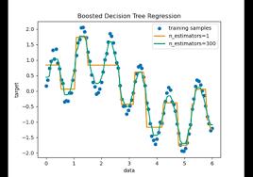
FLOW CHART

Slide 5
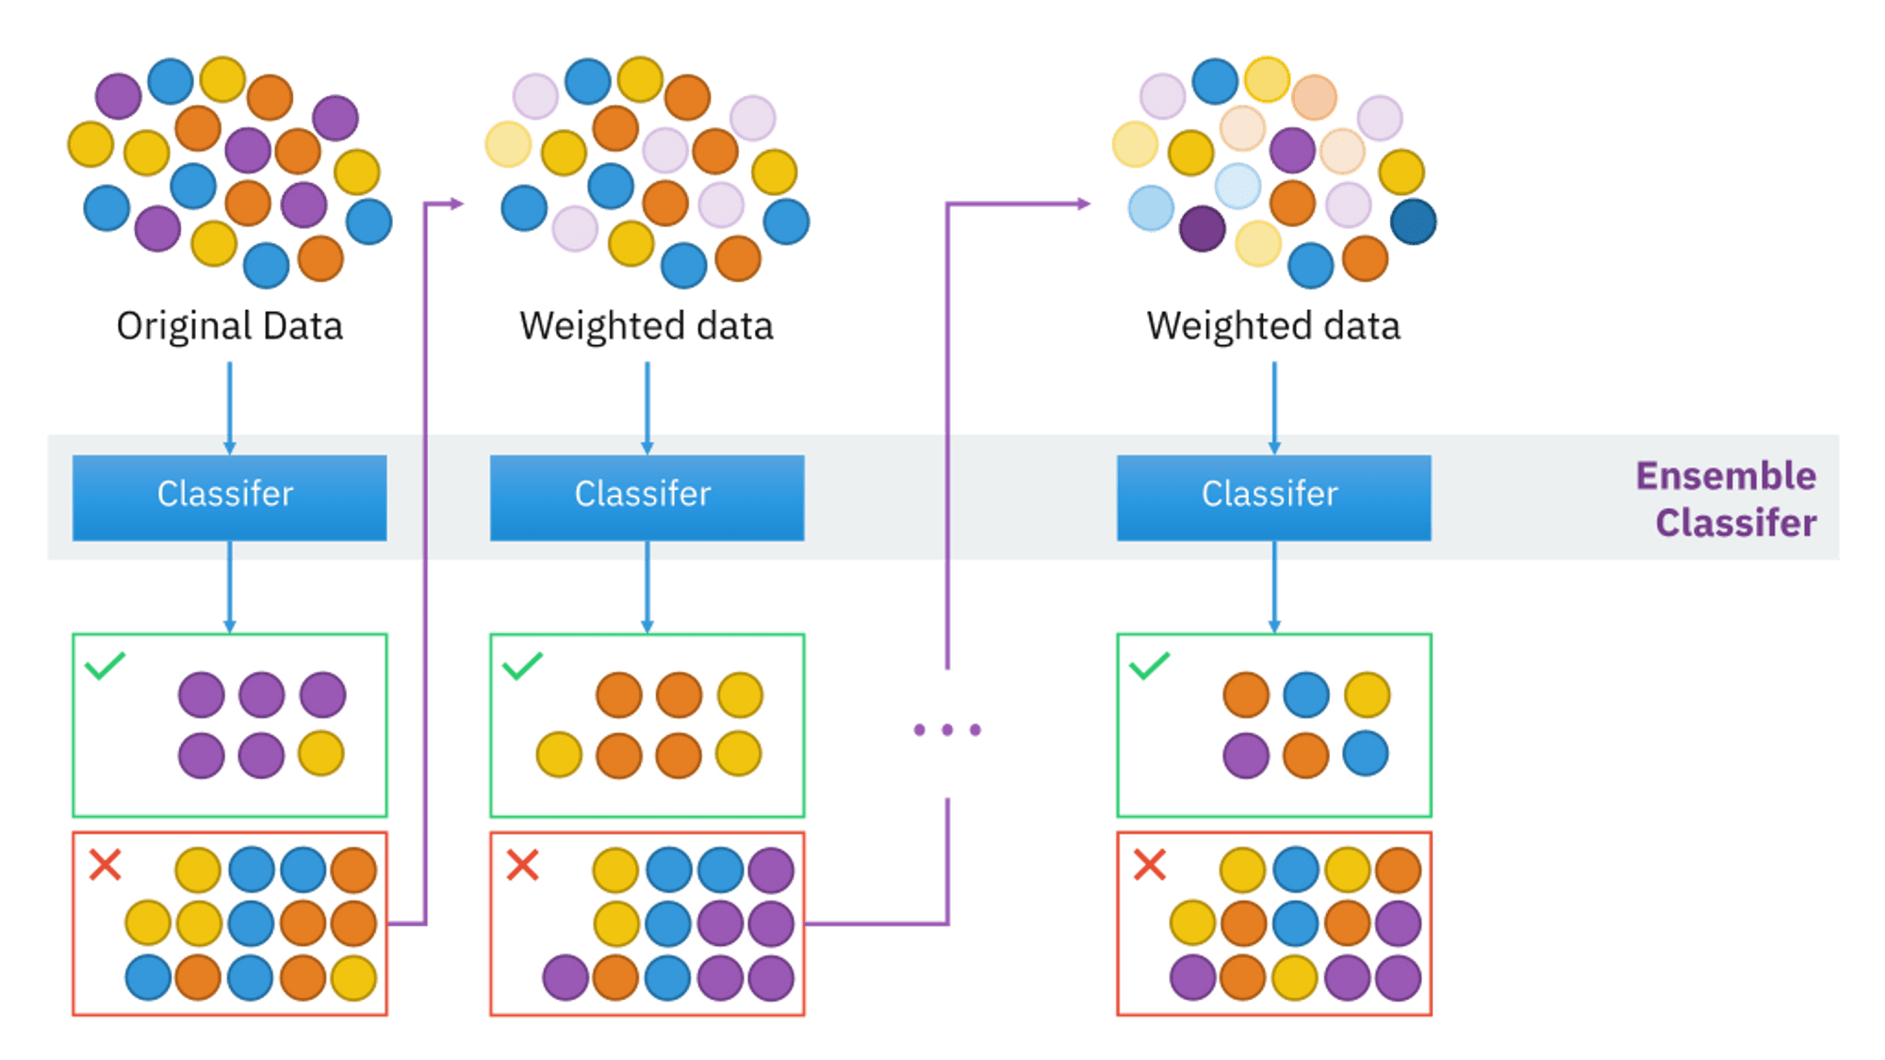

Slide 6
